Slide 1



Unmaze Your Mind
Discover a haven for mental health and well-being. Unmaze Your Mind offers a comprehensive suite of resources to support your journey towards emotional fulfillment and personal growth.

Slide 2


Shout your heart out
1
Shout Out
2
Emotional Outlet
A platform to freely express emotions, vent frustrations, and unload stress - a cathartic release for better mental health.
Provides a safe space to explore and process feelings, promoting emotional well-being and self-awareness.
3
Authentic Expression
Encourages users to be true to themselves, fostering a sense of empowerment and emotional resilience.

Slide 3
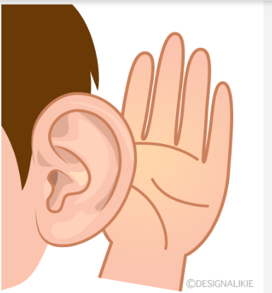
A Listening Ear
Need a Listener
Compassionate Support
Meaningful Connections
Connects users with attentive, empathetic listeners who provide a supportive, non-judgmental environment to share thoughts and feelings.
Offers a safe haven for individuals seeking someone to confide in, promoting emotional healing and well-being.
Fosters supportive relationships and a sense of community, reducing feelings of isolation and loneliness.

Slide 4




Expert Guidance
Therapists
Counselors
Life Coaches
Support Groups
Licensed mental health professionals offering personalized counseling and evidence-based treatment approaches.
Experienced guides providing support, advice, and strategies for navigating life's challenges.
Coaches who empower individuals to set and achieve personal goals, fostering growth and self-improvement.
Peer-led groups where individuals can connect, share experiences, and find solidarity in their mental health journeys.

Slide 5
Additional Resources
Self-Help Books
Calming Music
Curated selection of self-help and mental wellness books to foster personal growth and development.
Soothing soundtracks and playlists to promote relaxation, mindfulness, and stress reduction.
Uplifting Wallpapers
Motivational Videos
Inspirational and visually pleasing desktop and mobile wallpapers to enhance your digital environment.
Empowering videos featuring personal stories, affirmations, and tips for cultivating a positive mindset.

Slide 6
Connect and Thrive
Online Forums
Support Groups
Peer-to-Peer Interactions
Virtual communities where users can share experiences, seek advice, and support one another through various mental health challenges.
Facilitated online groups that provide a safe space for individuals to come together, discuss their struggles, and find solidarity.
Fostering meaningful connections and relationships that can help reduce feelings of isolation and promote a sense of belonging.

Slide 7
Crisis Support
Immediate Assistance
Comprehensive Guidance
Access to crisis hotlines, emergency resources, and professional interventions for individuals experiencing acute mental health distress.
Provides users with essential information and referrals to appropriate support services, ensuring timely and effective crisis management.
Compassionate Care
24/7 Availability
Offers a safety net for those in need, with a commitment to treating all individuals with dignity, empathy, and respect.
Round-the-clock access to crisis support, ensuring that help is always available when individuals need it most.

Slide 8


Achieve Your Goals
Set Your Goals
Unlock Achievements
Identify your personal aspirations and break them down into actionable, measurable steps.
Earn badges and milestones that acknowledge your hard work and mental health accomplishments.
1
2
3
Track Your Progress
Utilize our intuitive tools to monitor your progress and celebrate small victories along the way.

Slide 9
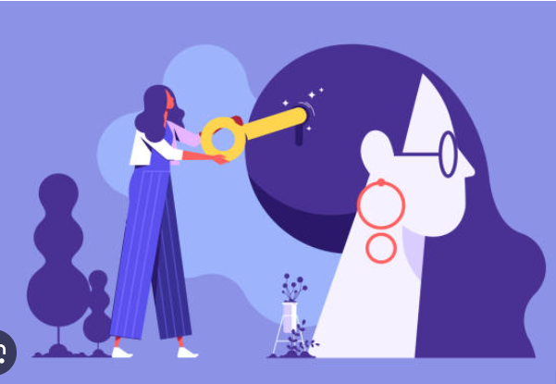



Uncover Your Potential
Explore
Dive into the vast array of resources and features Unmaze Your Mind has to offer.
Engage
Actively participate in the community, connect with others, and share your experiences.
Grow
Unlock your inner strength, cultivate resilience, and embark on a transformative journey of self-discovery.

Slide 10


Unlock Your Path to Wellness
Unmaze Your Mind is your gateway to a world of mental health support and personal empowerment. Start your journey today and unlock the full potential of your mind and well-being.

